Slide 1
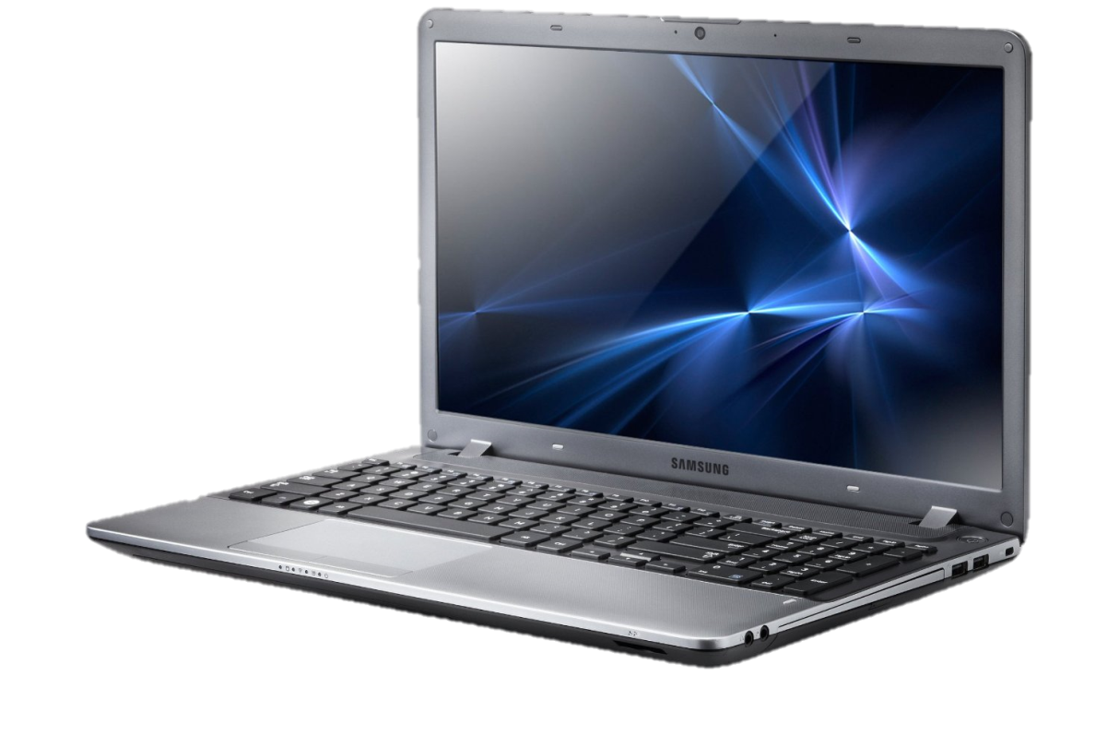
What is a computer?
A Computer is defined as an electronic device for storing or processing data. (Computer definition, 2016)
This can range from
  A calculator for students
  A smartphone for the working class
  A hearing aid for the elderly
They are in our lives from start to beginning.
(World Magacy, 2014)

Slide 2

Have computers bettered society?
Economic Aspect
Shane Rexford
AICE GLOBAL PERSPECTIVE
Period 6
(Question Mark Computer, 2016)

Slide 3
Computers benefit society
Create Jobs
Eliminating Jobs
Allow tourism to grow

Slide 4

Statistics
The Internet has created 1.2 million jobs, many paying higher salaries than average
Internet business contributes 2.1%, or $300 billion, to the total GDP (gross domestic product) of the U.S.
Internet-based advertising has increased four-fold since 2002 to more than $20 billion,
(Thibodeau, 2009)
(Internet Basics, 2016)

Slide 5


Creates jobs
America
UK
“Digitization is creating a second economy that’s vast, automatic, and invisible—thereby bringing the biggest change since the Industrial Revolution.” (The second economy | McKinsey & Company, 2011)
“Amazon is planning to create 2,500 jobs in the UK this year as part of the continued European expansion of its online retail and cloud computing operations.” (Amazon to create 2,500 UK jobs in Europe-wide recruitment drive, 2016)
(UK to restrict jobs going to overseas workers, 2016)
(Most Underrated Jobs In America: Not Glamorous, But Well-Paid And Low Stress – AOL, 2016)

Slide 6
Tourism
“Internet can be maximum exploited in the tourism industry for different types of marketing or promotional activities. Internet helps the tourism industry to expand and transfer its data which helps the industry to increase the turnover ratio and internet is the most suitable way to make direct relationship with customers. Tourism industry can achieve many advantages if internet is used wisely.” (The role of internet in hospitality and tourism industry’s IMC strategies Gr.151, 2015)
Tourism
Computers that allow the use of the internet
Success!

Slide 7
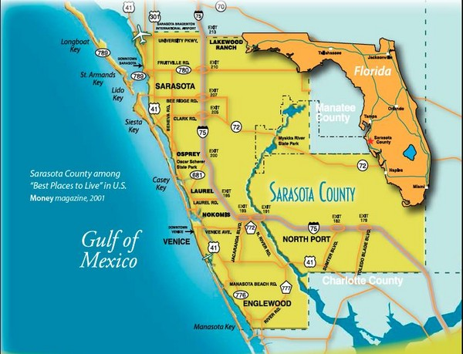
Tourism In my home town of Sarasota, fl
It is becoming of increasing importance to Florida’s economy because it includes a plethora of potential high-growth
Increasingly Florida tourism is becoming important to high-tech create 29,346 high-tech related jobs in 2010 through indirect impacts (15,450 jobs) and induced impacts (13,896).
Florida tourist expenditures are projected to produce $2.1 million in the form of total wages and salaries paid by the high-tech
contributing $3.4 billion in output through their indirect and induced impacts.
2.0% of 1.4 billion total tourist-generated jobs
3.3% of $63.1 billion in total tourist-generated wages
3.3% of $102.8 billion in total tourist-generated output.
(SPECIAL REPORT BY FLORIDA TAXWATCH CENTER FOR TOURISM THE IMPACT OF TOURISM ON FLORIDA’S ECONOMY: TELLING THE FULL STORY, 2016)
(Sarasota Map - Belspur Florida • mappery, 2016)

Slide 8
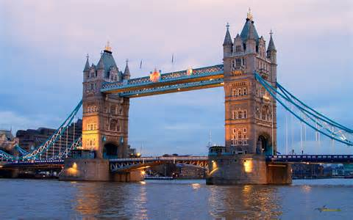
Tourism in The UK
“Two thirds of internet users take two or more holidays a year”
“55% of internet users book holidays online”
“Nine per cent of internet users book their holidays on the high street after researching online”
“17 per cent research holidays online then book over the telephone.”
“Half of all Internet users now book their holidays online.”
(Booking holidays and flights online, 2016)
(London Bridge, 2016)

Slide 9
Although some experts believe computers are eliminating jobs
“Computers have increasingly taken over such tasks as bookkeeping, clerical work, and repetitive production jobs in manufacturing—all of which typically provided middle-class pay.
(Rotman, 2013)
Lower paying jobs
Computers
Less Jobs

Slide 10

Jobs in Florida
“But state leaders are pushing for more, citing recent statistics from Code.org that reveal nearly 24,000 open computing jobs in Florida and fewer than 1,900 students earning computer science degrees from state universities each year.”
“In 2013, 1,521 Florida students took that AP exam. This year, 2,528 did.”
(Florida pushes for more computer science classes - Orlando Sentinel, 2015)
(People need more skill for job, 2016)

Slide 11

Jobs in the uk
Advances in robotics and computing could wipe out as much as a third of all UK jobs over the next 20 years, a new report has claimed. More than 10 million roles are likely to be replaced by automated systems, with repetitive, lower-paid jobs (those earning less than £30,000 a year) five times more likely to be made obsolete than higher-paid jobs.
(A third of UK jobs to be replaced by robots and computers in next 20 years | Tech | Lifestyle | The Independent, 2014)
(UK Economy, 2016)

Slide 12
Reflecting

Slide 13
references
AOL. (2016, April 27). Most Underrated Jobs In America: Not Glamorous, But Well-Paid And Low Stress - AOL. Retrieved from http://www.aol.com/article/2012/10/05/most-underrated-jobs-in-america-not-glamorous-but-well-paid-an/20338327/?jwp=1
Arthur. (2011, October). The second economy | McKinsey & Company. Retrieved from http://www.mckinsey.com/business-functions/strategy-and-corporate-finance/our-insights/the-second-economy
Bing. (2016, May 12). computer definition. Retrieved from http://www.bing.com/search?FORM=SK2JDF&PC=SK2J&q=computer+definition
Bing. (2016, April 27). London Bridge. Retrieved from https://www.bing.com/images/search?q=London+Bridge&view=detailv2&&id=65121DD5E077B073F0A23D8127195ACABB3A4022&selectedIndex=0&ccid=LAMYPgIX&simid=608009826389003455&thid=OIP.M2c03183e0217e53e76a080a126aaa23dH0&ajaxhist=0
Bing. (2016, April 27). People need more skill for job. Retrieved from http://www.bing.com/images/search?q=people+need+more+skill+for+job&view=detailv2&&id=E7096ADD3C8534FBF00EECE110EFB43678E51BCB&selectedIndex=16&ccid=u8hsS5sg&simid=607996172690787701&thid=OIP.Mbbc86c4b9b205b2dd310035660af76b4o0&ajaxhist=0
Bing. (2016, April 27). uk economy. Retrieved from http://www.bing.com/images/search?q=uk+economy&view=detailv2&&id=9BDBDA2C33FEA35F254202AEB1D5C67A0C6B07DE&selectedIndex=0&ccid=wbDl9TRZ&simid=608001129079243407&thid=OIP.Mc1b0e5f53459ec6590031e57560ccaf8H0&ajaxhist=0
Donnelly. (2016, January 22). Amazon to create 2,500 UK jobs in Europe-wide recruitment drive. Retrieved from http://www.computerweekly.com/news/4500271532/Amazon-to-create-2500-UK-jobs-in-Europe-wide-recruitment-drive
Florida TaxWatch Center. (2016, April 20). SPECIAL REPORT BY FLORIDA TAXWATCH CENTER FOR TOURISM THE IMPACT OF TOURISM ON FLORIDA’S ECONOMY: TELLING THE FULL STORY. Retrieved from http://www.cefa.fsu.edu/content/download/47182/327651/file/florida_tourism03.pdf
Google. (2016, April 27). question mark computer. Retrieved from https://www.google.com/search?q=question&biw=1280&bih=923&source=lnms&tbm=isch&sa=X&ved=0ahUKEwjgm5qe6qzMAhUFeD4KHQxDDzYQ_AUIBigB&safe=active&ssui=on#safe=active&tbm=isch&q=question+mark+computer&imgrc=SSMIqpygSWOVSM%3A
Harvest Digital. (2016, April 20). Booking holidays and flights online. Retrieved from http://www.bima.co.uk/assets/members/whitepapers/050808041f120705_1.pdf
Harvest Digital. (2016, April 20). Digital Marketing Agency London | Harvest Digital. Retrieved from http://www.harvestdigital.com/
Hisham and Qian. (2015, September 13). The role of internet in hospitality and tourism industry’s IMC strategies Gr.151. Retrieved from https://mpk732t22015.wordpress.com/2015/09/13/the-role-of-internet-in-hospitality-and-tourism-industrys-imc-strategies/
Mappery. (2016, April 27). Sarasota Map - Belspur Florida • mappery. Retrieved from http://www.mappery.com/sarasota-map
NDTV. (2016, April 27). UK to restrict jobs going to overseas workers. Retrieved from http://www.ndtv.com/world-news/uk-to-restrict-jobs-going-to-overseas-workers-400986
Postal. (2015, November 22). Florida pushes for more computer science classes - Orlando Sentinel. Retrieved from http://www.orlandosentinel.com/features/education/os-computer-science-florida-schools-20151122-story.html
Quest Internet 101. (2016, April 27). Internet Basics. Retrieved from http://www.questnet101.com/
Rotman. (2013, June 12). How Technology Is Destroying Jobs. Retrieved from https://www.technologyreview.com/s/515926/how-technology-is-destroying-jobs/
Thibodeau. (2009, June 10). Study: Internet economy has created 1.2M jobs | Computerworld. Retrieved from http://www.computerworld.com/article/2525229/internet/study--internet-economy-has-created-1-2m-jobs.html
Vincent. (2014, November 10). A third of UK jobs to be replaced by robots and computers in next 20 years | Tech | Lifestyle | The Independent. Retrieved from http://www.independent.co.uk/life-style/gadgets-and-tech/a-third-of-uk-jobs-to-be-replaced-by-robots-and-computers-in-next-20-years-9851119.html
World Magacy. (2014). What Are The Best Laptop Brands – 10 Top Laptop Brands For You. Retrieved April 27, 2016, from http://www.worldmagacy.com/what-are-the-best-laptop-brands-10-top-laptop-brands/

